Slide 1






Enhanced environmental protection inspection for efficient control of air quality monitoring and of all entities under obligation within system of greenhouse gas emission allowance trading, in order to achieve better quality of air in Republic of Croatia
This project is funded by the European Union

Slide 2



THEME 6: QA/QC (quality assurance/quality control)
Energy Research and Environmental Protection Institute
Mato Papić dipl. ing. stroj.
Bojan Abramović dipl. ing. stroj.

Slide 3

6.1 TARGETED DATA QUALITY
According to ISO 8402, we can say that:
The quality - the totality of the characteristics of an entity that demonstrates its ability to comply with the stated or implied requirements and / or needs.
Targeted data quality - represents the legal minimum required for the quality of data obtained by air quality measurements in one year.
Energy Research and Environmental Protection Institute

Slide 4
6.1 TARGETED DATA QUALITY
Only data that can be used to document the target quality can be used to run any kind of legally prescribed procedures.
Almost all measurements of air quality are determined by regulatory or inspection. Because of this, achieving and documenting the targeted quality of data sets as the primary goal of all QA / QC procedures in a network.
Energy Research and Environmental Protection Institute

Slide 5
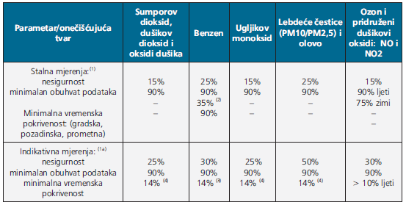
6.1 TARGETED DATA QUALITY
Targeted data quality
Energy Research and Environmental Protection Institute

Slide 6
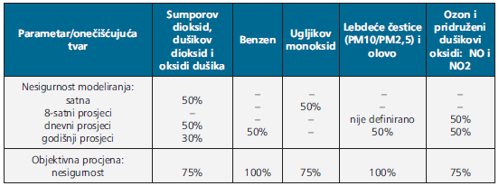
6.1 TARGETED DATA QUALITY
Targeted data quality (extension table)
Energy Research and Environmental Protection Institute

Slide 7
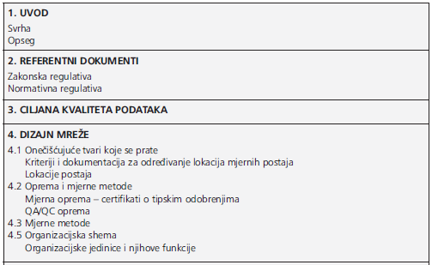
6.2 QA/QC PLAN NETWORK
QA/QC plan network is the basic document on quality assurance of measurements in each network. It contains all the basic information on how quality assurance network is organized. QA/QC plan should have the following structure:
Energy Research and Environmental Protection Institute

Slide 8
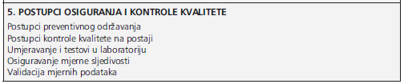
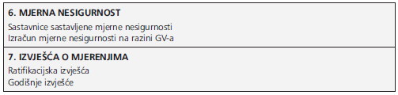
6.2 QA/QC PLAN NETWORK
Extension table
Energy Research and Environmental Protection Institute

Slide 9
6.2 QA/QC PLAN NETWORK
Below I will briefly discuss all the chapters that should include a QA / QC plan with special emphasis on the section on quality assurance and quality assurance procedures.
INTRODUCTION
In the introduction it is necessary to mention the importance of quality assurance and briefly define the purpose and scope of the document. It is also necessary to specify the basic goals of the network, as well as the reasons for its establishment.
Energy Research and Environmental Protection Institute

Slide 10
6.2 QA/QC PLAN NETWORK
2. REFERENCE DOCUMENTS
This is an extremely important chapter. It should contain all reference documents that are referred to in the plan and which regulate and normatively define the operation of the network. By referring to legally or normatively defined methods of metering, and their consistent implementation and documenting, we ensure not only compliance but also disable the often malicious attempts to undermine the quality assurance of measurement. This also ensures the results of measurements that can be in practice and which are not acceptable to some.
Energy Research and Environmental Protection Institute

Slide 11
6.2 QA/QC PLAN NETWORK
The Croatian regulation is almost fully harmonized with the European one. However, some of the guidelines issued by various environmental bodies in the EU can be of great help in defining QA / QC procedures.
Regulations Of The REPUBLIC Of CROATIA
The law on air protection (Official Gazette, no. 130/11, 47/14, 61/17)
Rulebook on monitoring air quality (Official Gazette 79/17)
Ordinance on the mutual exchange of information and the reporting of air quality and commitments for the implementation of the decisions of the Commission 2011/850/EU (Official Gazette 3/16)
The regulation on the levels of pollutants in the air (OFFICIAL GAZETTE 117/12)
Energy Research and Environmental Protection Institute

Slide 12
6.2 QA/QC PLAN NETWORK
Regulations and guidelines of the EU
Directive 2008/50/EC of the European Parliament and of the Council
Commission Directive (EU) 2015/1480
Implementing the Commission's decision of 12. December 2011. laying down rules for Directive 2004/107/EC and 2008/50/EC of the European Parliament and of the Council concerning the mutual exchange of information and reporting on the quality of the air (2011/850/EU)
Guidance on the Decision 2011/850/EU
„Criteria for EUROAIRNET The EEA Air Quality Monitoring and Information Network“; EEA Technical Report No. 12
“QA/QC checks on air quality data in AIRBASE and on the EoI 2004 data Procedures and results”; ETC/ACC Technical paper 2005/3 September 2005; Wim Mol and Patrick van Hooydonk
Energy Research and Environmental Protection Institute

Slide 13
6.2 QA/QC PLAN NETWORK
When referring to the normative regulation in the QA / QC plan, it is necessary to state the general normative acts under which the measurements are carried out and to note that specific norms are mentioned in the lower quality assurance documents. The most important general normative acts relevant to quality assurance in the area of air quality are:
• HRN EN ISO / IEC 17025 - General requirements for the qualification of testing and calibration laboratories
• ENV 13005, Guide to the expression of uncertainty in
• measurement
• EN ISO 14956:2002 Air quality. Evaluation of the suitability of a measurement
procedure by comparison with a required measurement uncertainty.
Energy Research and Environmental Protection Institute

Slide 14
6.2 QA/QC PLAN NETWORK
3. TARGETED DATA QUALITY
It is necessary to mention the target quality data set for the pollutant and the types of measurement / modeling that are implemented in the network.
4. NETWORK DESIGN
In this chapter it is necessary to specify in detail how the network is designed. When writing this chapter that refers to points 4.1 to 4.3 QA/QC plan should respect the provisions of the regulations on the exchange of information about the data from the network for permanent monitoring of air quality (OFFICIAL GAZETTE 135/06) which defines the so-called metadata about the network, and each individual station.
Energy Research and Environmental Protection Institute

Slide 15
6.2 QA/QC PLAN NETWORK
5. Quality insurance control
The primary goal of QA / QC procedures is to ensure targeted data quality and provide documentation that will document it. The quality system shall be written in accordance with the provisions of the EN ISO / IEC 17025 – General requirements for the competence of testing and calibration laboratories and certain prescribed measurement methods standards. Although each network has its own specifics, insurance and quality control for automatic measurements typically consists of the below described procedures.
Energy Research and Environmental Protection Institute

Slide 16
6.2 QA/QC PLAN NETWORK
Preventive maintenance procedures
Preventive maintenance of instruments is based on measurement methods, equipment manufacturer recommendations and experience. Typically consists of:
• regular status verification of the instrument's technical validity
• regular service and checking of the station
• regular maintenance of the system for sampling
• the regular annual services.
Energy Research and Environmental Protection Institute

Slide 17
6.2 QA/QC PLAN NETWORK
Quality control procedures at the stations
Quality control procedures on the station should be designed on the basis of the norms of the measurement methods, the recommendations of the manufacturer of the equipment and the experience. These procedures are used primarily to control the daily work of the instruments, or the total of the measuring system. This gives regular insight into the functionality of the instruments and enables a timely reaction to irregularities in the work of instruments that could otherwise remain unnoticed for a long time.
Energy Research and Environmental Protection Institute

Slide 18
6.2 QA/QC PLAN NETWORK
Quality control procedures at the stations usually consist of:
• checking the response og the zero gas "ZERO CHECKING„
• checking the response of the calibration gas "SPAN CHECKING„
• calibration at two points
• recertification of gases
• testing of the sampling line
• testing of the sampler manifolds.
Energy Research and Environmental Protection Institute

Slide 19
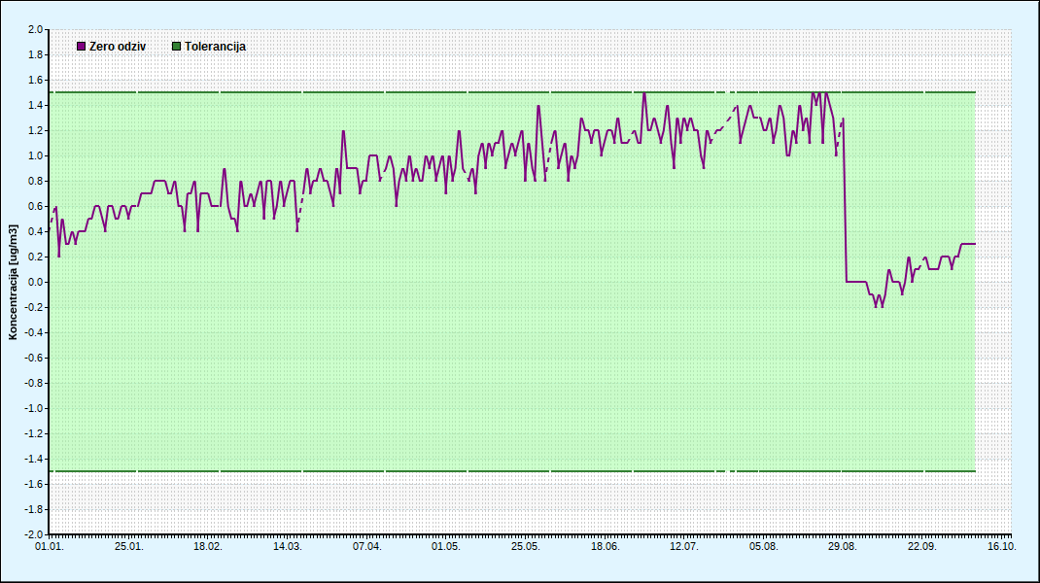
6.2 QA/QC PLAN NETWORK
Quality control procedures at the stations
Energy Research and Environmental Protection Institute

Slide 20
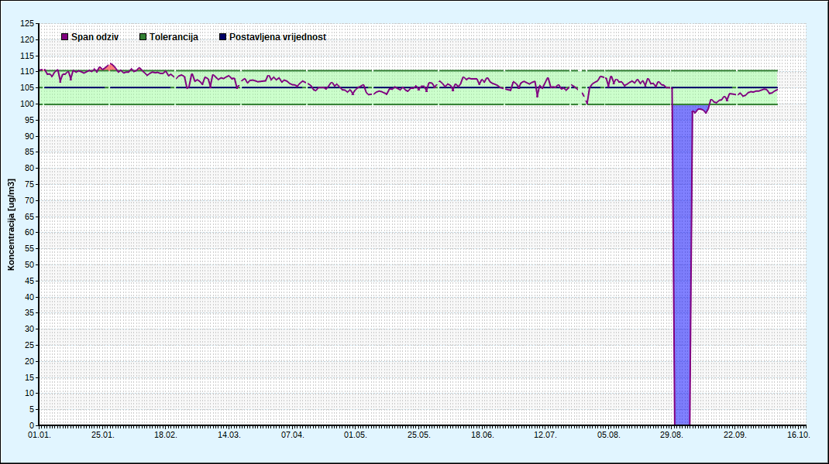
6.2 QA/QC PLAN NETWORK
Quality control procedures at the stations
Energy Research and Environmental Protection Institute

Slide 21
6.2 QA/QC PLAN NETWORK
Calibration and tests in the laboratory
After each annual service or after major servicing of the instrument the calibration and testing of the instrument is performed in a calibration laboratory. Such tests, as well as, quality control data in the station together with the data
obtained during the performance of the type approval tests are used to calculate the measurement uncertainty that is being carried out each year. Operating performance tests are designed based on standardized metering methods. Also for the conducted tests, in the standards for certain methods, the acceptable limits have to be met.
Energy Research and Environmental Protection Institute

Slide 22
6.2 QA/QC PLAN NETWORK
Such procedures typically consist of:
• calibration with certified or primary standards
• "lack of fit" test in three or four points and zero gas
• testing of repeatability standard deviation
• testing of short-term offset
Energy Research and Environmental Protection Institute

Slide 23
6.2 QA/QC PLAN NETWORK
For the purpose of quality assurance and quality control, documentation is developed which describes the procedures and establishes documents that document the regular conduct of the procedures.
Performing procedures should ensure the proper functioning of the equipment both in the technical and in the analytical sense, enable the prediction of possible problems and their avoidance or elimination as soon as possible.
All completed procedures need to be well documented and kept in line with the legal and normative regulations.
Energy Research and Environmental Protection Institute

Slide 24
6.2 QA/QC PLAN NETWORK
DOCUMENTATION
Energy Research and Environmental Protection Institute

Slide 25
6.2 QA/QC PLAN NETWORK
6. MEASUREMENT UNCERTAINTY
Based on the data from the type approval, laboratory tests and station tests, the parameters are calculated as follows:
the measurement uncertainty for the data from the period to be reported in the annual report in the form of an expanded uncertainty of uncertainty for the lowest defined averaging time at the Uc limit value
absolute expanded measurement uncertainty for averaging time at the limit value Uc
relative measurement uncertainty Uc (relative measurement uncertainty should be expressed for each individual instrument in the network.)
Energy Research and Environmental Protection Institute

Slide 26
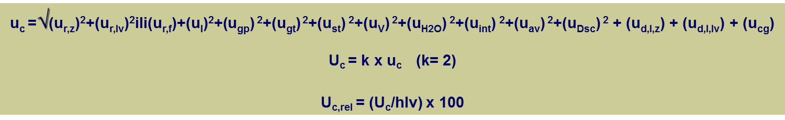
6.2 QA/QC PLAN NETWORK
MEASUREMENT UNCERTAINTY
Energy Research and Environmental Protection Institute

Slide 27
6.2 QA/QC PLAN NETWORK
Measurement uncertainty is calculated in accordance with ENV 13005, Guide to the expresion of uncartainity in measurement i EN ISO 14956:2002 Air quality, Evaluation of the suitability of a measurement procedure by comparison with a required measurement uncertainty and CEN standards for individual pollutants.
7. Measurement reports
The laboratory that performs measurements in a particular network over the year informs the network coordinator through the ratification reports about the network operation and the measurement results. Likewise, at the end of the one-year measurement period set by regulation, the laboratory appends an annual report
Energy Research and Environmental Protection Institute

Slide 28
6.2 QA/QC PLAN NETWORK
Ratification Report
The Ratification Report is a periodic report in which the laboratory reports to the coordinator or network owner on all aspects of network operation and ratifies the measurement data for a specific period. Such reports are usually produced for a period of one to three months, depending on the requirements of the network owner. They are not obligatory and they are a matter of contract.
Yearly report
It is produced after the end of a one-year period.
Energy Research and Environmental Protection Institute

Slide 29
6.3 MEASUREMENT TRACEABILITY AND CALIBRATION LABORATORY
Automatic instruments for monitoring the air quality require strict quality control of measurements. One of the most important quality assurance procedures is regularly calibration and testing of the instruments. The calibration is done at the stations and in the calibration laboratories. Calibration laboratory should ensure and document the accuracy and traceability of the measuring data and allow for the expression of measurement uncertainty at the level of the limit values for each instrument in the network. Only with the good cooperation of the testing and the calibration laboratories (with the support of the service team) can reach the extremely challenging regulatory target the quality of the data.
Energy Research and Environmental Protection Institute

Slide 30
6.3 MEASUREMENT TRACEABILITY AND CALIBRATION LABORATORY
The calibration of instruments and measurement traceability
The calibration of the instruments is carried out periodically. CEN-standards require calibration of instruments at stations every three months. This procedure is performed with the help of a certified gas cylinders (CRM certified referent material CRM) at two points (zero and the so-called span which represents a concentration of 70 to 80% of the maximum certified measurement range) which ensures traceability.
It is also necessary to perform calibration in the laboratory after each major instrument intervention (major repairs, annual service). This is followed by testing performance of the instrument required by the same standards.
Energy Research and Environmental Protection Institute

Slide 31
6.3 MEASUREMENT TRACEABILITY AND CALIBRATION LABORATORY
The most common and the most useful tests are so called. "LACK OF FIT" test (which represents the linearity test and is most often performed in 5 points within the measurement range), “STANDARD DEVIATIONS REPEATABILITY" test (which checks the repeatability of the instrument) and “SHORT TERM DRIFT" test which checks the stability of the measurements in a short period. If the instrument after the calibration meets the standard prescribed criteria for the above tests and if the calibration is ensured traceability, the prepared instrument is ready for measurements at the station. Calibration in laboratories is also carried out with the help of traceable reference materials.
Energy Research and Environmental Protection Institute

Slide 32
6.3 MEASUREMENT TRACEABILITY AND CALIBRATION LABORATORY
"lack of fit" test in three or four points and zero gas
Energy Research and Environmental Protection Institute

Slide 33
6.3 MEASUREMENT TRACEABILITY AND CALIBRATION LABORATORY
standard deviation repeatability test
Energy Research and Environmental Protection Institute

Slide 34
6.3 MEASUREMENT TRACEABILITY AND CALIBRATION LABORATORY
A national reference laboratory is required to ensure traceability of measurement for devices for automatic monitoring of air quality in the State network. (2008/50/EC Art. 3 Ann. AND C)
The traceability to the SI standard is achieved by the use of:
the primary standard gases (PRM) or gases certified in accredited laboratories (CRM)
calibration of calibrators in the accredited laboratories
regular proficiency testing with reference laboratory instruments organized by JRC (Ref. Lab EU) - WHO - AQUILA
Energy Research and Environmental Protection Institute

Slide 35
6.3 MEASUREMENT TRACEABILITY AND CALIBRATION LABORATORY
ČMI Brno
NMI Delft
Linde Prag
UBA Beč
NPL London
LNI Geneve
FMI Helsinki
Several prominent institutions from which Croatian reference laboratory provide measuring traceability:
Energy Research and Environmental Protection Institute

Slide 36
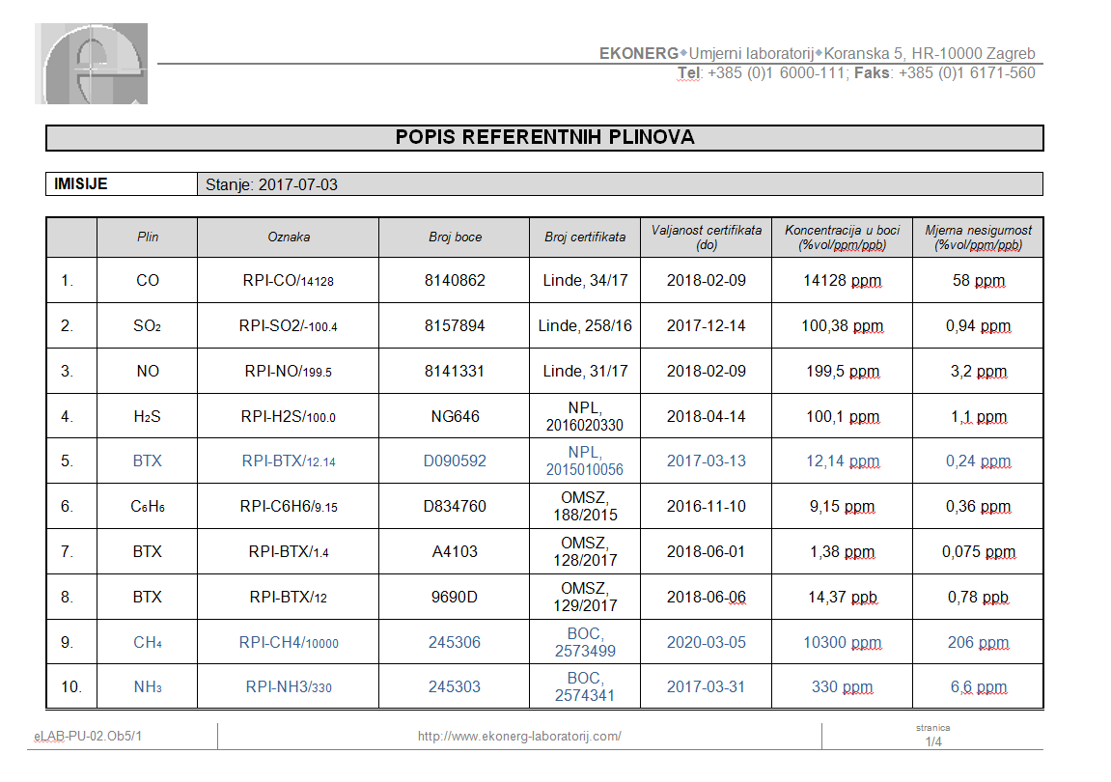
6.3 MEASUREMENT TRACEABILITY AND CALIBRATION LABORATORY
calibration with certified or primary standards
Energy Research and Environmental Protection Institute

Slide 37
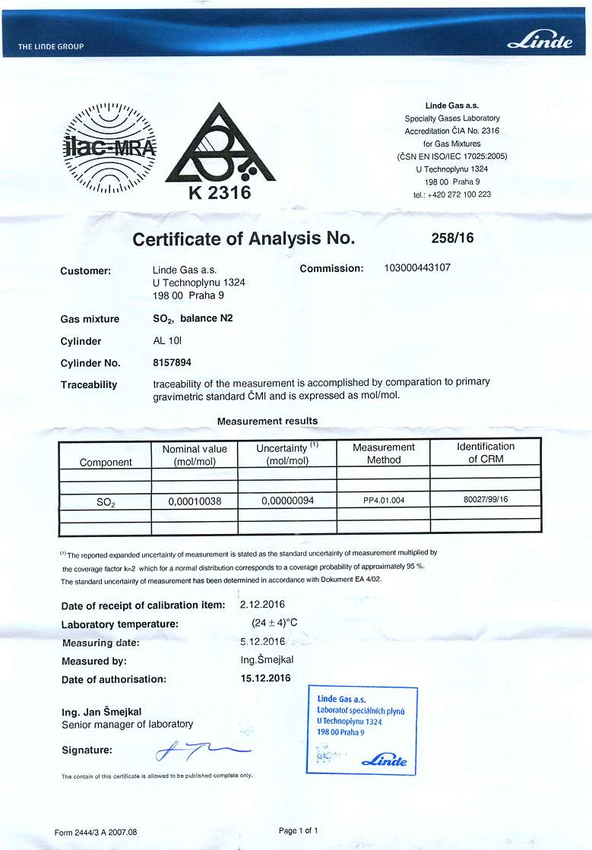
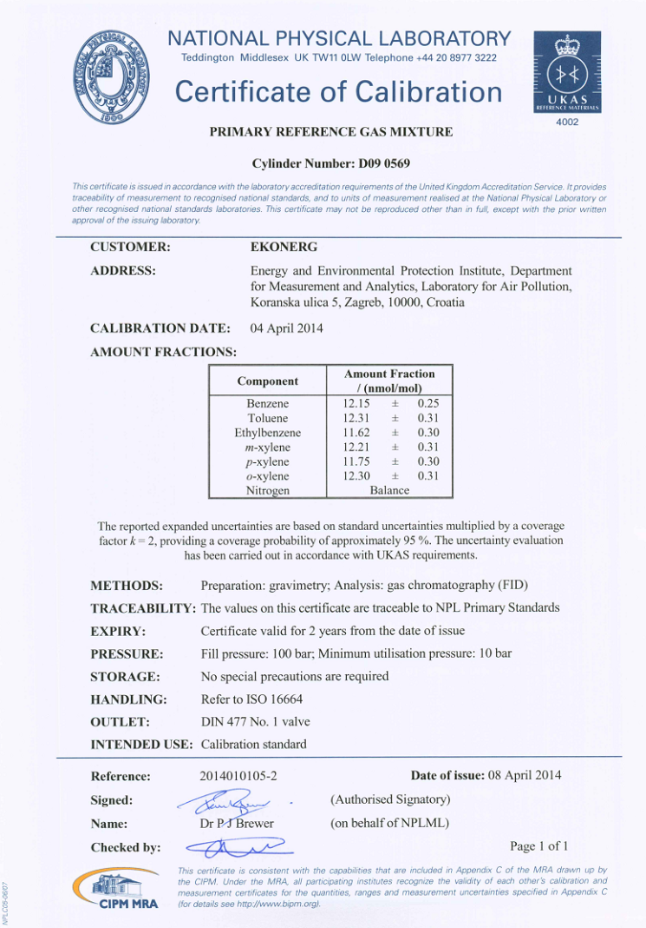
6.3 MEASUREMENT TRACEABILITY AND CALIBRATION LABORATORY
calibration with certified or primary standards
Energy Research and Environmental Protection Institute

Slide 38
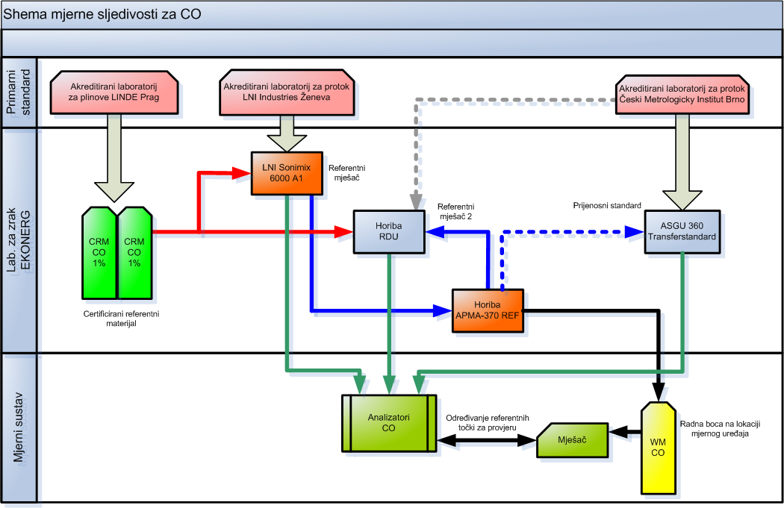
6.3 MEASUREMENT TRACEABILITY AND CALIBRATION LABORATORY
Energy Research and Environmental Protection Institute

Slide 39

6.3 MEASUREMENT TRACEABILITY AND CALIBRATION LABORATORY
Energy Research and Environmental Protection Institute

Slide 40
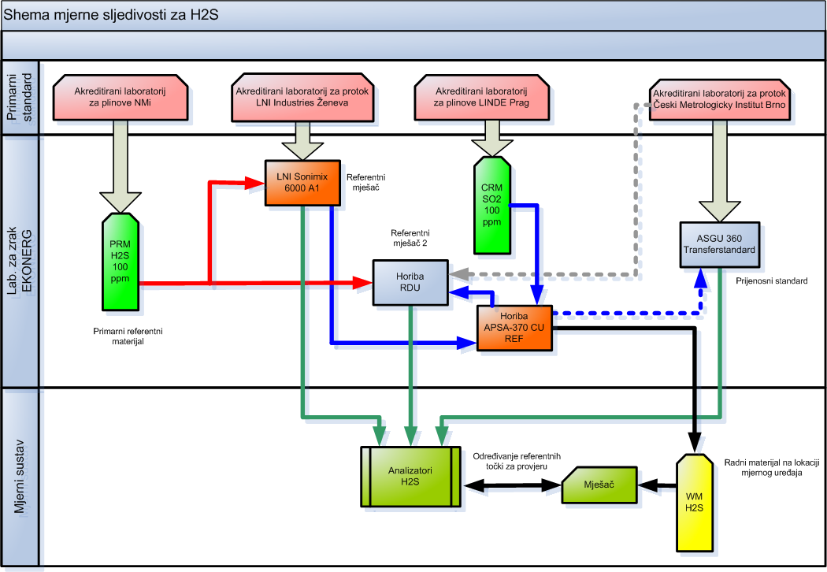
6.3 MEASUREMENT TRACEABILITY AND CALIBRATION LABORATORY
Energy Research and Environmental Protection Institute

Slide 41
6.3 MEASUREMENT TRACEABILITY AND CALIBRATION LABORATORY
Only traceable instruments achieve valid results !!!!
Energy Research and Environmental Protection Institute

Slide 42
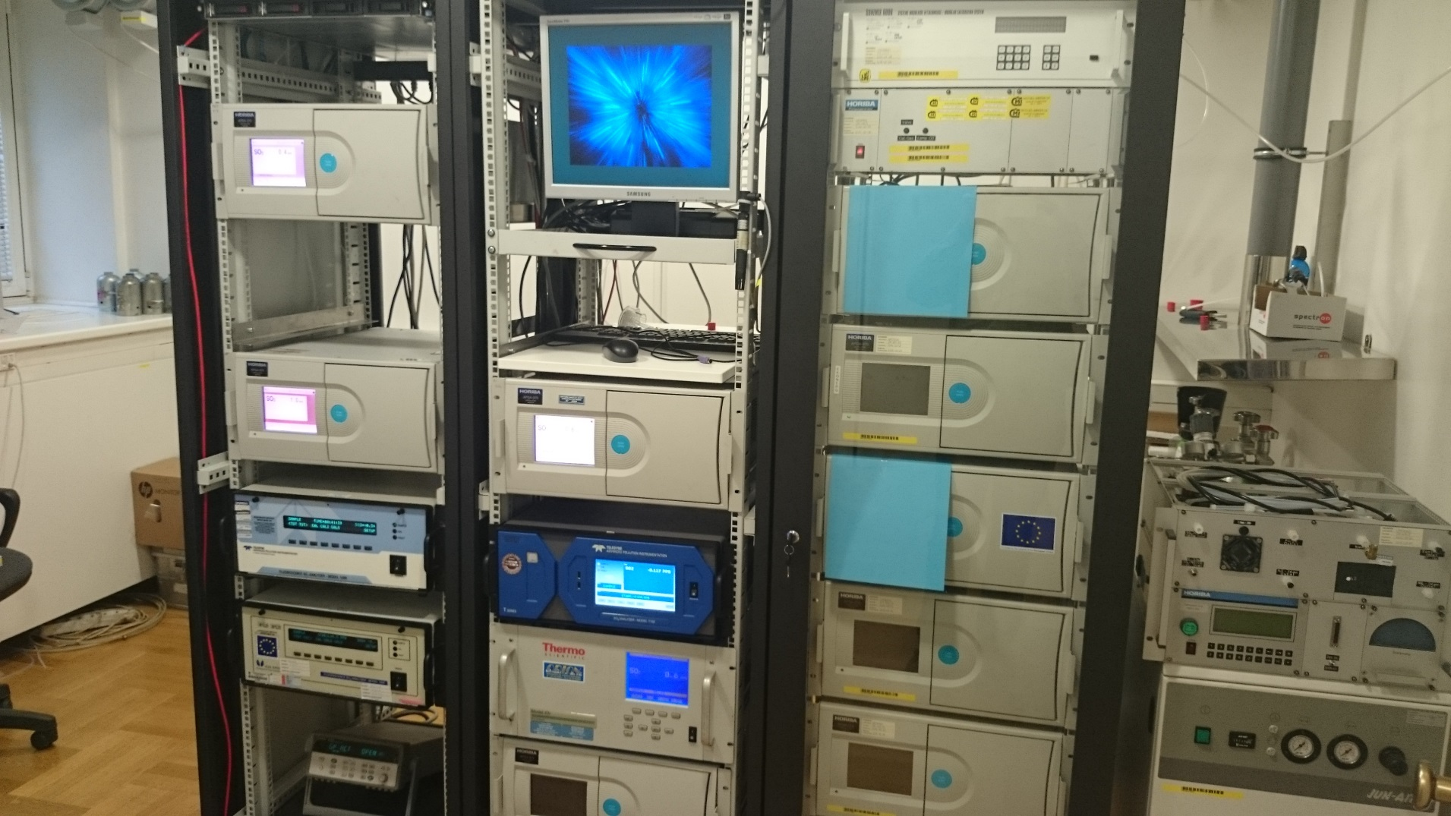
6.3 MEASUREMENT TRACEABILITY AND CALIBRATION LABORATORY
Energy Research and Environmental Protection Institute

Slide 43
6.4 Interlaboratory comparisons (Proficiency testing)
Quality assesment
Interlaboratory comparisons are an additional process for assuring and verifying accuracy and traceability (Quality assessment).
These measurements are actually measurements of the same gas in several laboratories at the same time. For the gaseous pollutants are organized in laboratory conditions.
With the help of specially designed systems, it is possible to measure the pollutants of known concentrations simultaneously.
Energy Research and Environmental Protection Institute

Slide 44
6.4 Interlaboratory comparisons (Proficiency testing)
Interlaboratory comparisons represent the highest level in the process of harmonization of measurement and in Europe they are organized by the European Commission (through its ERLAP reference laboratory) in cooperation with the World Health Organization. Each the national reference laboratory of the European Union Member State is obliged to perform Interlaboratory comparisons with its reference instruments at least once every three years. National Reference Laboratories then organize such Interlaboratory comparisons for laboratories in their countries.
Energy Research and Environmental Protection Institute

Slide 45
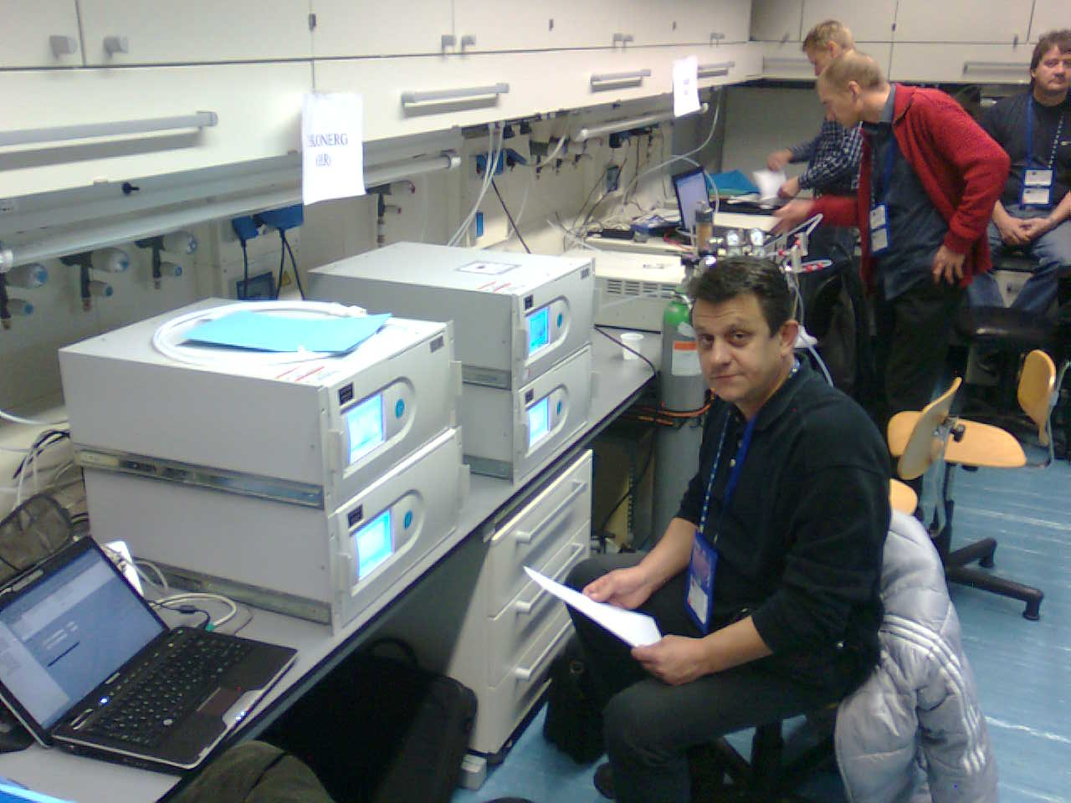

6.4 Interlaboratory comparisons (Proficiency testing)
IE ERLAP JRC, Ispra –2008
Energy Research and Environmental Protection Institute

Slide 46
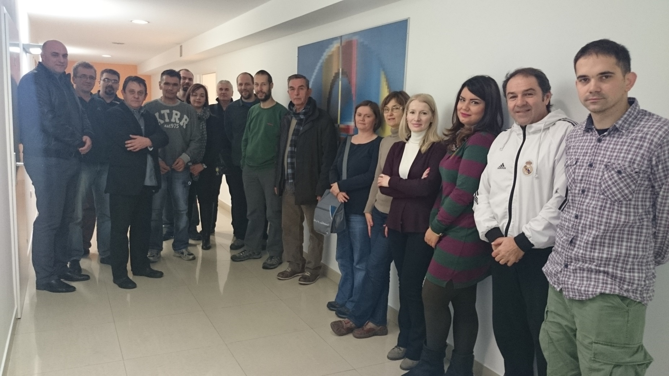
6.4 Interlaboratory comparisons (Proficiency testing)
EKONERG, Zagreb –2014
Energy Research and Environmental Protection Institute

Slide 47
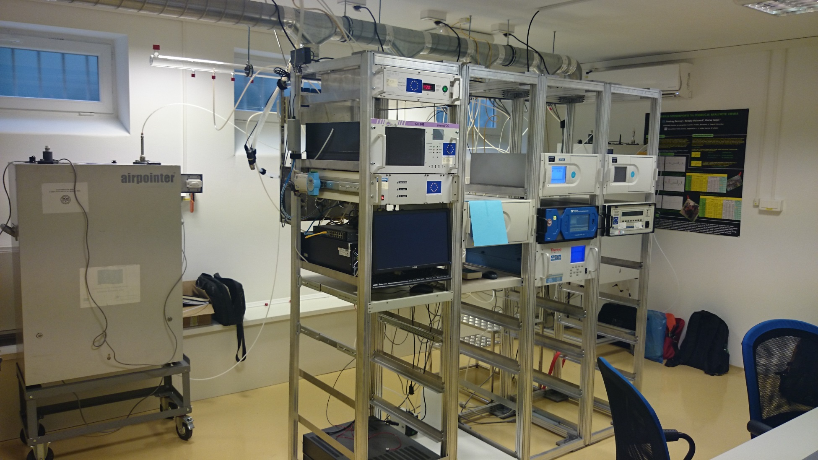
6.4 Interlaboratory comparisons (Proficiency testing)
Energy Research and Environmental Protection Institute

Slide 48
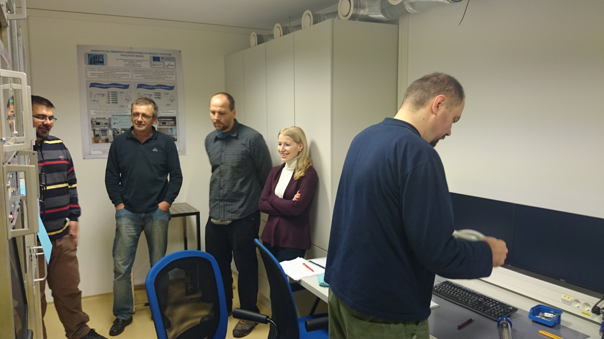
6.4 Interlaboratory comparisons (Proficiency testing)
Energy Research and Environmental Protection Institute

Slide 49
6.4 Interlaboratory comparisons (Proficiency testing)
After the measurement is completed, the measurement results of each laboratory are compared and analysed. The results of each laboratory's measurement must meet certain criteria in terms of measurement accuracy and expressed measurement uncertainty for each measured concentration.
Energy Research and Environmental Protection Institute

Slide 50
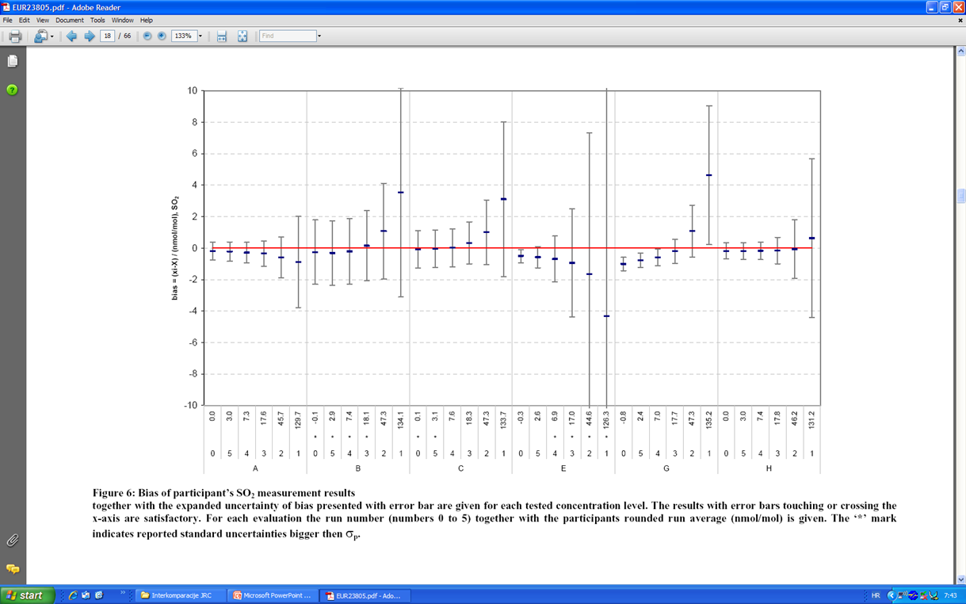
6.4 Interlaboratory comparisons (Proficiency testing)
Energy Research and Environmental Protection Institute

Slide 51
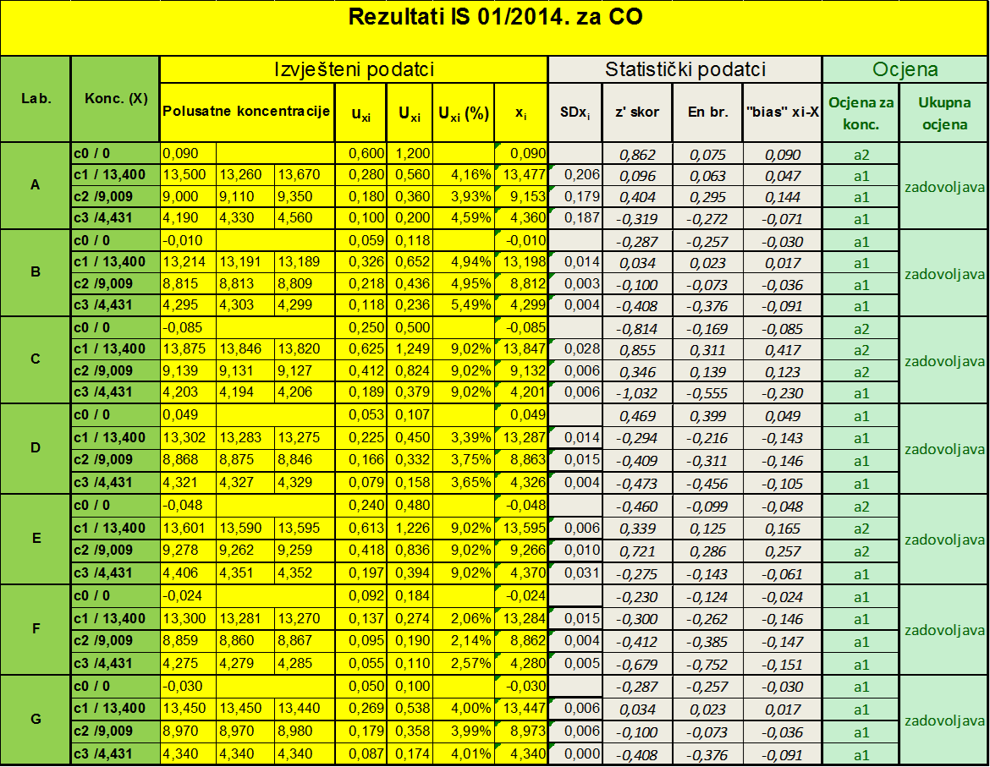
6.4. Interlaboratory comparisons (Proficiency testing)
Energy Research and Environmental Protection Institute

Slide 52
6.3 Interlaboratory comparisons (Proficiency testing)
Quality assesment
ACCREDITATION HRN EN ISO/IEC 17025
Internal independent audit 1 per year
HAA audit 1 per year
Reaccrediation every 5 years
Energy Research and Environmental Protection Institute

Slide 53
THANK YOU FOR YOUR ATTENTION
Energy Research and Environmental Protection Institute
Disclaimer: The contents of this publication are the sole responsibility of EKONERG – Energy Research and Environmental Protection Institute, Ltd. and can in no way be taken to reflect the views of the European Union
This project is funded by the European Union

